Slide 1



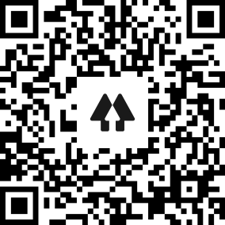
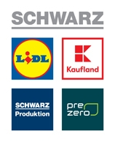


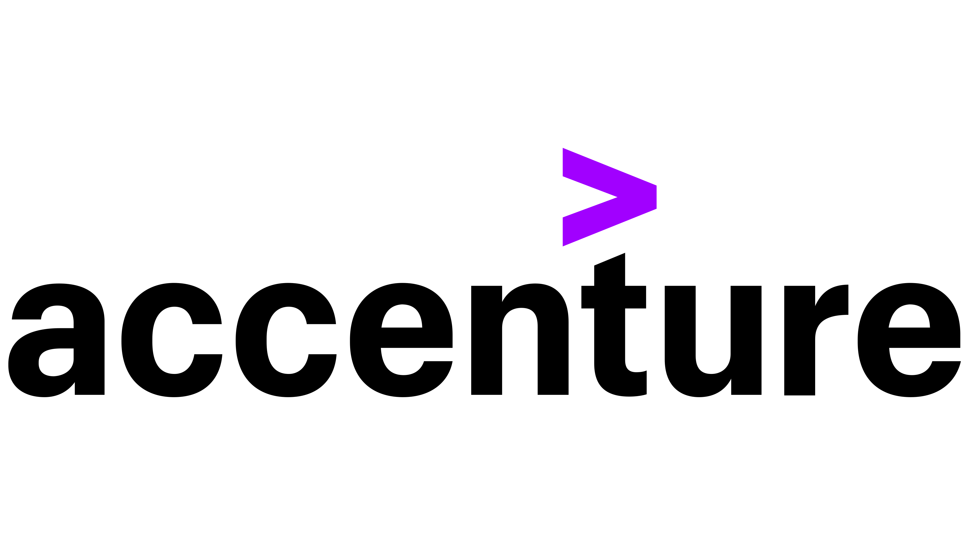
In the current situation of increased remote working, having a common, simple medium of communication such as an OpenAPI spec document is indispensable in meeting your requirements when building APIs.
Things get even more exciting when this so-called document can:
Serve as a contract
Generate clients, servers, and documentation in a plethora of languages
Put your developers and client first
Have Automatic, Fail-fast, API Validation
Is Cross-Platform and Language Agnostic
Is both human and machine readable in YAML or JSON
Speeds up development, prototyping, etc.
Reduces costs
Things get even more interesting in the live demo!
API-first! Contract-first! Make API development great again!
Atanas L. Kuzmanov
Senior Software Engineer
IT Solution Development
SchwarzIT Bulgaria
Currently:
As previously seen at:
Java2Days 2022:
https://www.youtube.com/watch?v=FW-m_j4yINU
HackConf 2021:
https://www.youtube.com/watch?v=yqrZMEraAJ8
IstaCon 2021:
https://www.youtube.com/watch?v=t_mjnH-vOaQ
SITCon 2021:
https://app4you.schwarz/services/SITcon/SitePages/Throwback--SITCONSTRUCT-2021.aspx
Previously:
{
}
https://github.com/atkuzmanov
https://www.linkedin.com/in/atkuzmanov/
https://twitter.com/atkuzmanov
https://linktr.ee/atkuzmanov https://atkuzmanov.wordpress.com/

